Slide 1
Conversational Search
CORIA – EARIA
Pierre-Emmanuel Mazaré
Facebook AI Research (Paris)
March 18-22, 2019

Slide 2
This Presentation:
Machine Reading with deep learning
Deep learning for dialogue

Slide 3
Machine Reading
Machines understanding text?

Slide 4
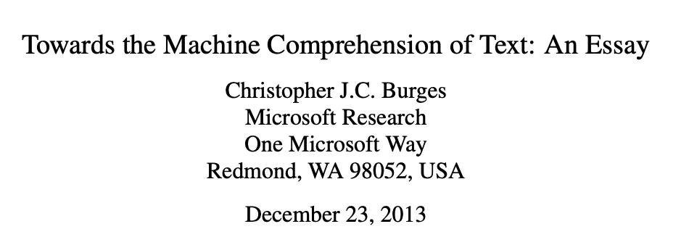
Machine Reading
“A machine comprehends a passage of text if, for any question regarding that text that can be answered correctly by a majority of native speakers, that machine can provide a string which those speakers would agree both answers that question, and does not contain information irrelevant to that question.”
Notes:
Connect machine reading with human comprehension

Slide 5
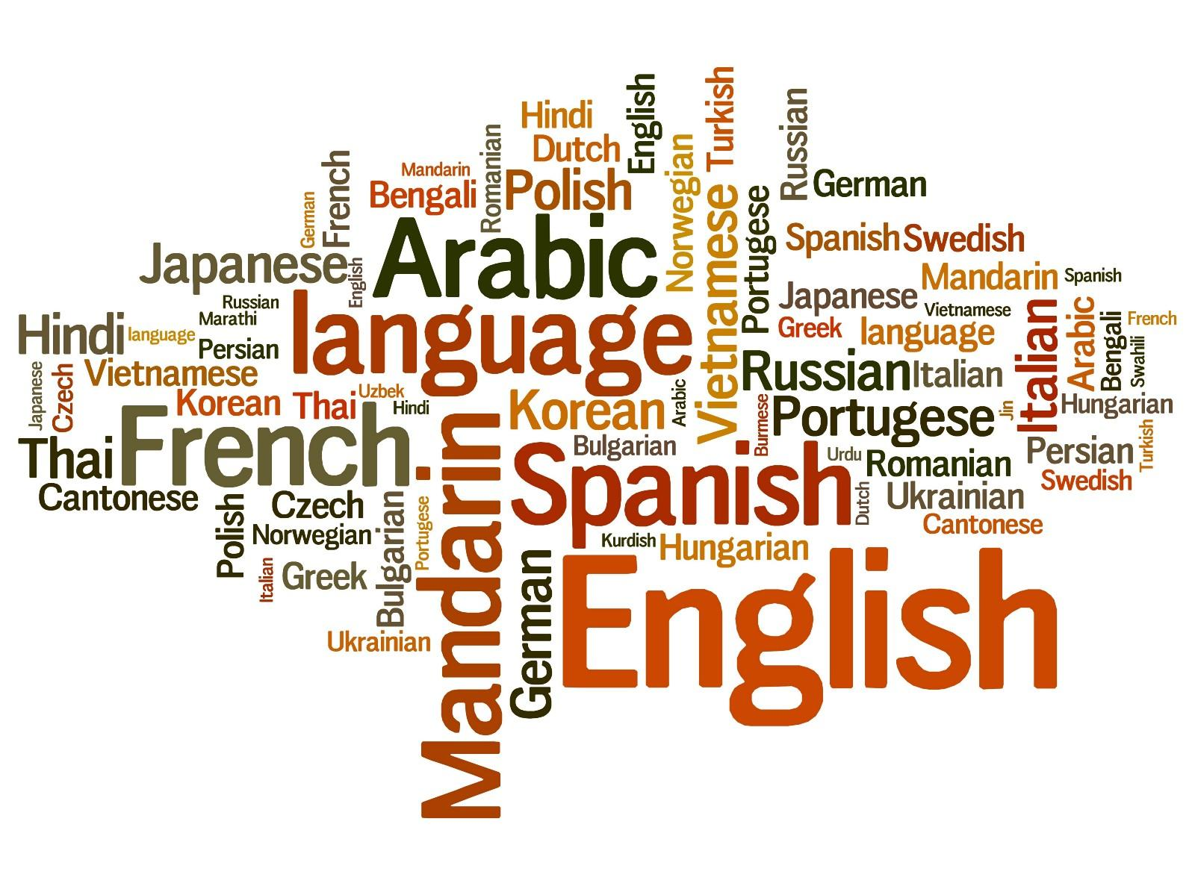


Machine Reading
In January 1880, two of Tesla's uncles put together enough money to help him leave Gospić for Prague where he was to study. Unfortunately, he arrived too late to enrol at Charles-Ferdinand University; he never studied Greek, a required subject; and he was illiterate in Czech, another required subject. Tesla did, however, attend lectures at the university, although, as an auditor, he did not receive grades for the courses.
[Passage of Text]
[Information Need]
uses for

Slide 6
Machine Reading
In January 1880, two of Tesla's uncles put together enough money to help him leave Gospić for Prague where he was to study. Unfortunately, he arrived too late to enrol at Charles-Ferdinand University; he never studied Greek, a required subject; and he was illiterate in Czech, another required subject. Tesla did, however, attend lectures at the university, although, as an auditor, he did not receive grades for the courses.
?
[Passage of Text]
[Meaning]
[Information Need]
converts into
uses for

Slide 7
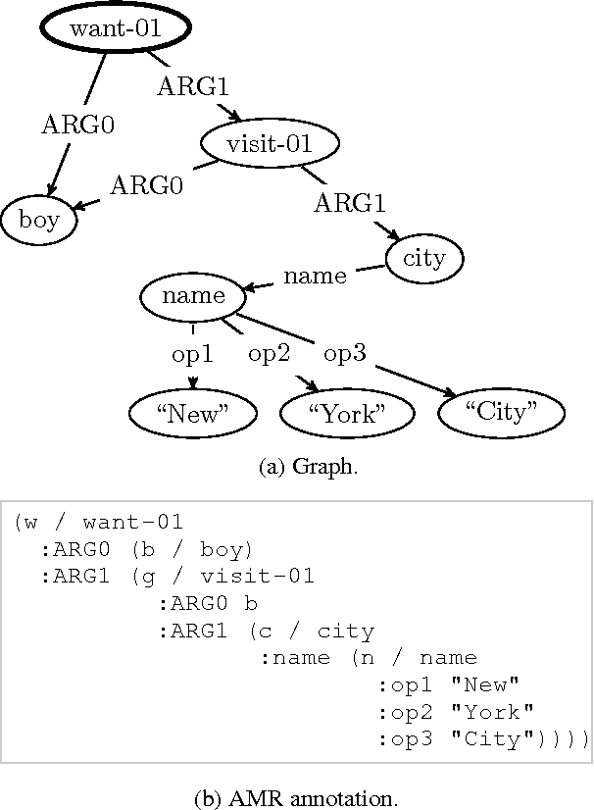
Symbolic Approaches (until 2014 or so)
In January 1880, two of Tesla's uncles put together enough money to help him leave Gospić for Prague where he was to study. Unfortunately, he arrived too late to enrol at Charles-Ferdinand University; he never studied Greek, a required subject; and he was illiterate in Czech, another required subject. Tesla did, however, attend lectures at the university, although, as an auditor, he did not receive grades for the courses.
?
[Passage of Text]
[Meaning]
[Information Need]
converts into
uses for

Slide 8
End-to-End Approaches (since 2014 or so)
In January 1880, two of Tesla's uncles put together enough money to help him leave Gospić for Prague where he was to study. Unfortunately, he arrived too late to enrol at Charles-Ferdinand University; he never studied Greek, a required subject; and he was illiterate in Czech, another required subject. Tesla did, however, attend lectures at the university, although, as an auditor, he did not receive grades for the courses.
[Passage of Text]
[Meaning?]
[Information Need]

Slide 9
Stanford Question Answering Dataset (SQuAD)
Rajpurkar et. al., EMNLP’16
Dataset size: 107,702 samples
Widely used benchmark dataset
Task: Extractive Question Answering
  System has to predict the start and end position of the answer in the passage of text

Slide 10
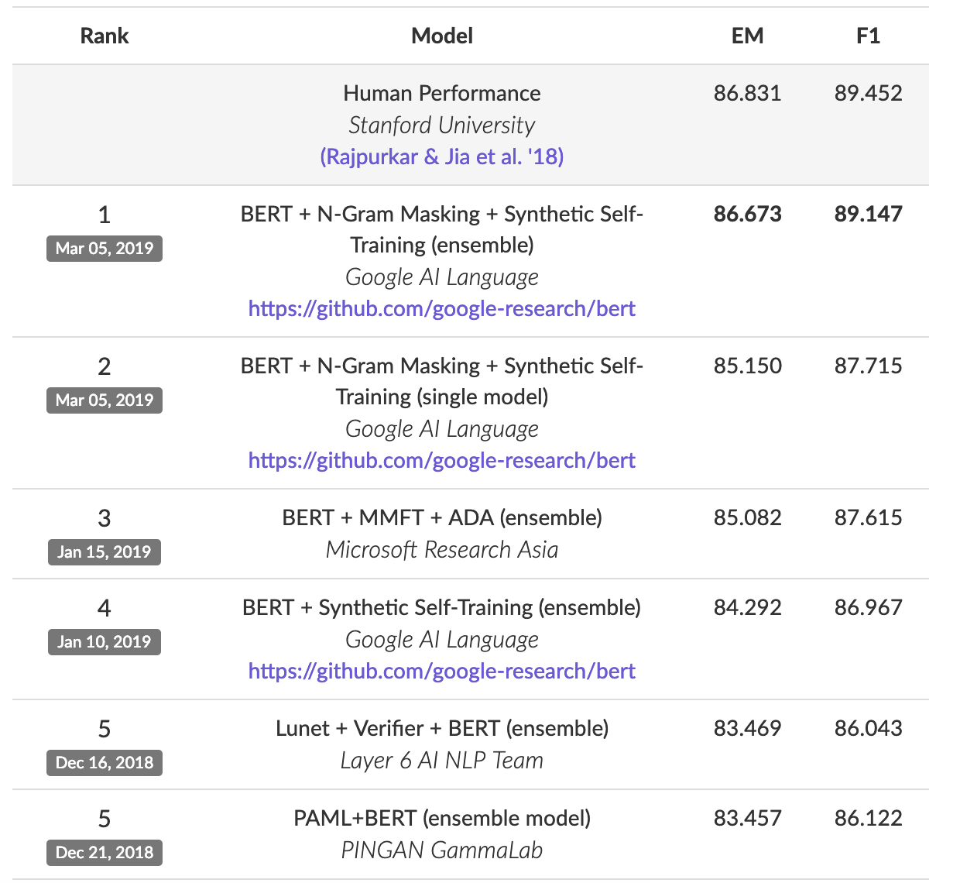
Stanford Question Answering Dataset (SQuAD)
Text Passage
Question + Answer
[...] Precipitation forms as smaller droplets coalesce via collision with other rain drops or ice crystals within a cloud. Short, intense periods of rain in scattered locations are called “showers”.
Where do water droplets collide with ice crystals to form precipitation?
Task: Given a paragraph and a question about it, predict the text span that states the correct answer.
within a cloud
Very popular leaderboard!
https://stanford-qa.com

Slide 11
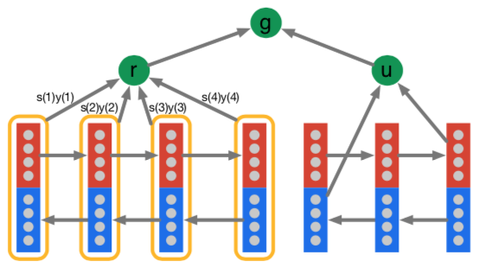
The Attentive Reader Model: Overview
Hermann et al., NIPS’15
answer
‘early’ neural model for Machine Reading
main components reused in many other models
Precipitation
forms
as
smaller
How
do
water
Modified visualization from Hermann et. al. NIPS’15
Notes:
Say that we model symbols by one-hot vectors.
We embed by a linear projection to much lower dimensionality → solves the aformentioned problem of high-dimensional feature spaces, however, such models have at least 1 hidden layer, no linear models anymore → backpropagation and DL to the rescue.
Projection matrix is often called the embedding matrix.
Talk about word embeddings, and or character embeddings.

Slide 12
The Attentive Reader Model: Overview
Answer Selection:
answer prediction
answer
Sequence Interaction:
Matching text with question
Composition: incorporating context around words
Input: Representing symbols as vectors
Precipitation
forms
as
smaller
How
do
water
Modified visualization from Hermann et. al. NIPS’15
Notes:
Say that we model symbols by one-hot vectors.
We embed by a linear projection to much lower dimensionality → solves the aformentioned problem of high-dimensional feature spaces, however, such models have at least 1 hidden layer, no linear models anymore → backpropagation and DL to the rescue.
Projection matrix is often called the embedding matrix.
Talk about word embeddings, and or character embeddings.

Slide 13

Representations for words: Embeddings
rain
precipitation
mozzarella
Similar meaning of words → similar vector representations – see previous lectures!

Slide 14
The Attentive Reader Model: Overview
answer
Composition: incorporating context around words
Input: Representing symbols as vectors
Precipitation
forms
as
smaller
How
do
water
Modified visualization from Hermann et. al. NIPS’15
Notes:
Say that we model symbols by one-hot vectors.
We embed by a linear projection to much lower dimensionality → solves the aformentioned problem of high-dimensional feature spaces, however, such models have at least 1 hidden layer, no linear models anymore → backpropagation and DL to the rescue.
Projection matrix is often called the embedding matrix.
Talk about word embeddings, and or character embeddings.

Slide 15
Representing Words in Context
“move from Gospić to Prague”
“leave Gospić for Prague”
“leave Prague for Gospić”
Word vector for Prague
Word vector for Prague
Word vector for Prague
Word representations should vary depending on context
Notes:
In our example with Tesla, we see that the same idea is expressed in two different ways
Our goal is to learn representations that...

Slide 16
Representing Words in Context
“move from Gospić to Prague”
“leave Gospić for Prague”
“leave Prague for Gospić”
Contextual representation of Prague
Contextual representation of Prague
Contextual representation of Prague
Word representations should vary depending on context
Contextual word representation:
  a word representation, computed conditionally on the given context
Notes:
Vector for Prague should be different depending on context.
Representation should be conditioned on context

Slide 17
Representing Words in Context
composition of word vectors into contextualized word representations
use vector composition function
“move from Gospić to Prague”
Contextual representations
Word representations
move
from
Gospić
to
Prague

Slide 18

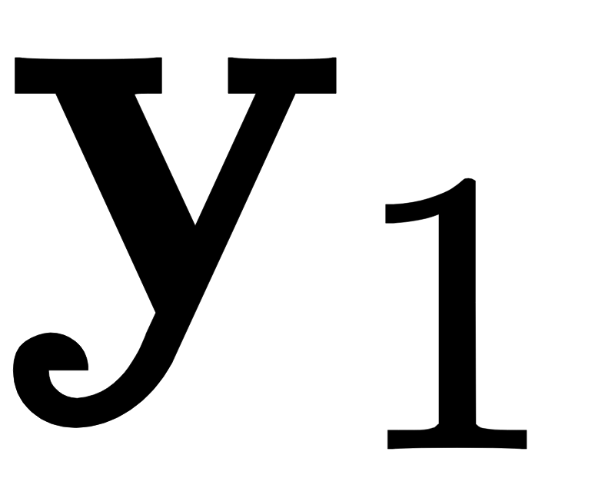
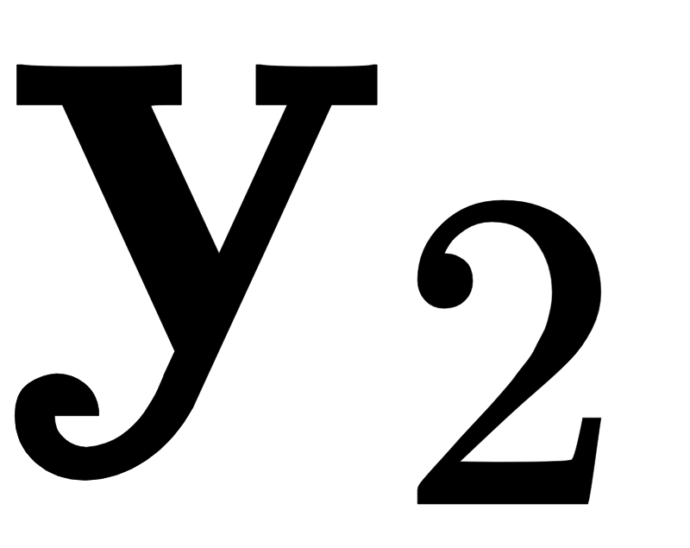
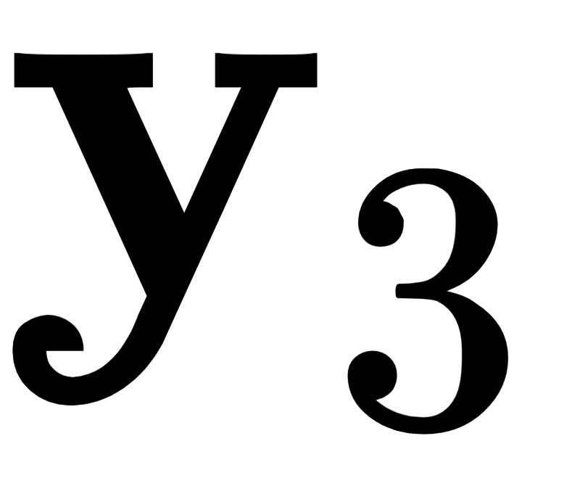
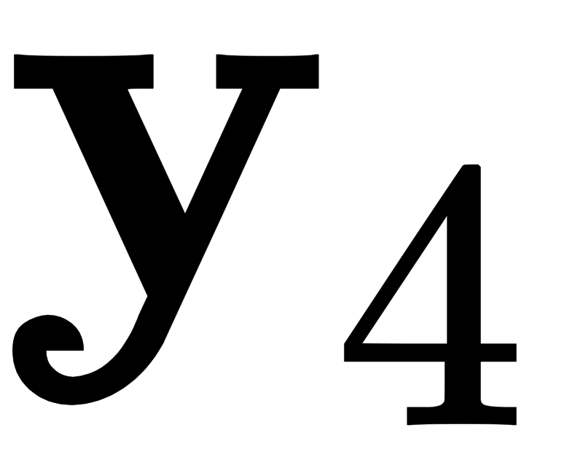
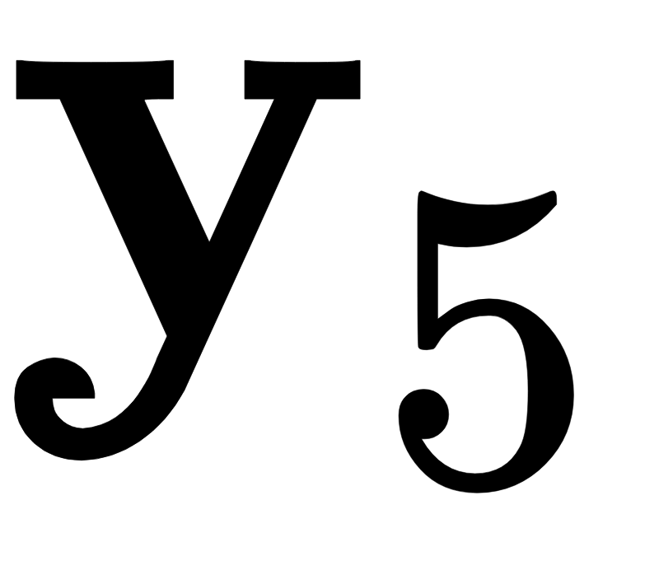

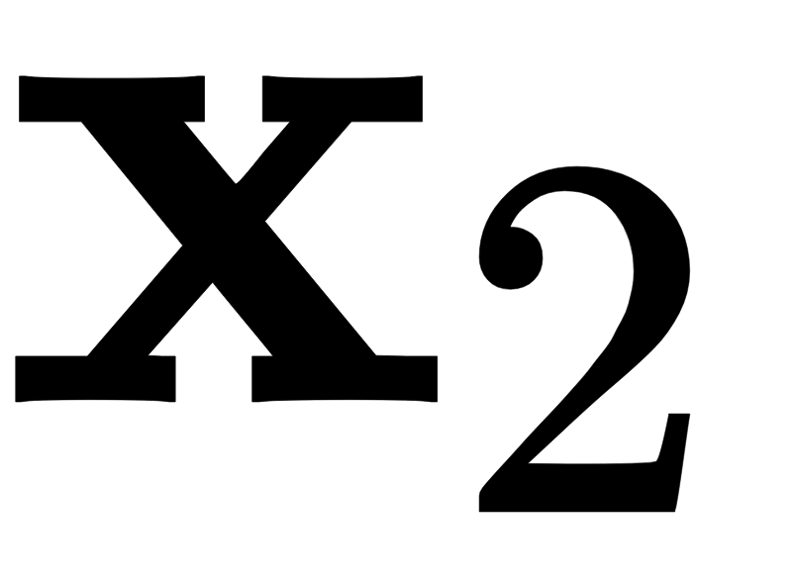
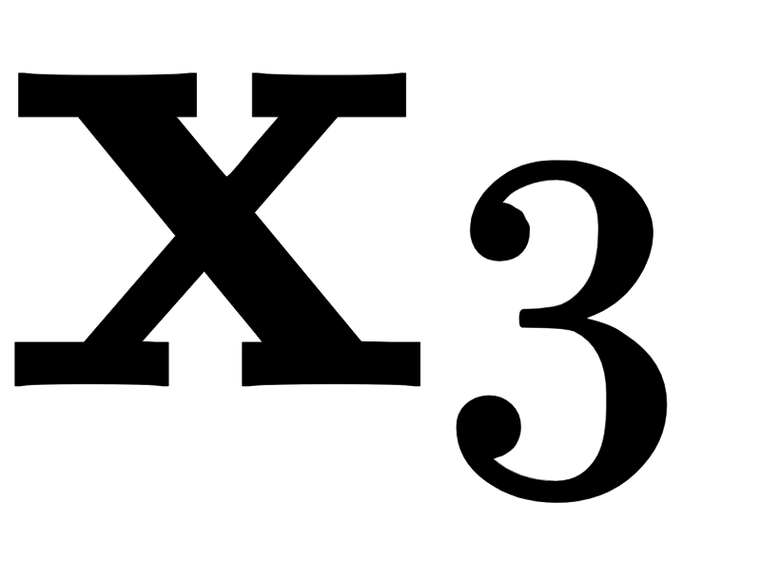
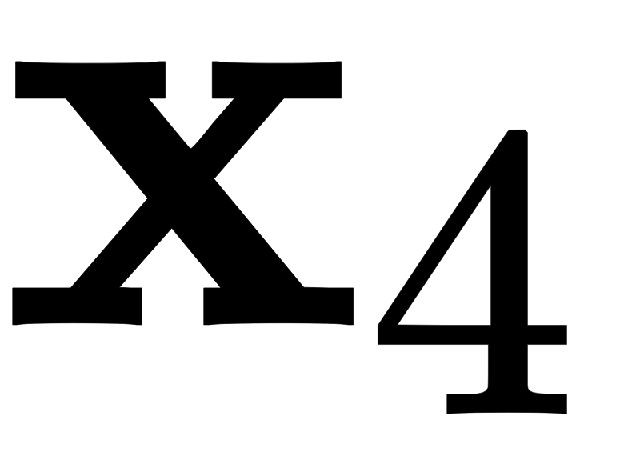


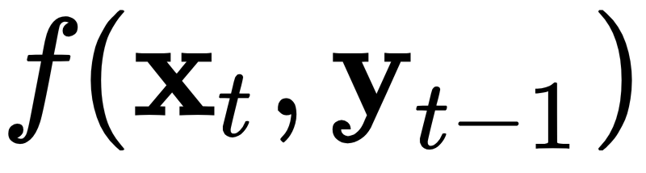
Recurrent Neural Network Layers
Idea: text as sequence
Prominent types: LSTM, GRU
Inductive bias: Recency
  more recent symbols have bigger impact on hidden state
Advantages
  everything is connected
  easy to train and robust in practice
Disadvantages
  Slow → computation time linear in length of text
  not good for (very) long range dependencies
Good for: sentences, small paragraphs
move
from
Gospić
to
Prague
Tree-variants:
TreeLSTM (Tai et al., SCL’15)
RNN Grammars (Dyer et al. NAACL’16)
Bias towards syntactic hierarchy

Slide 19

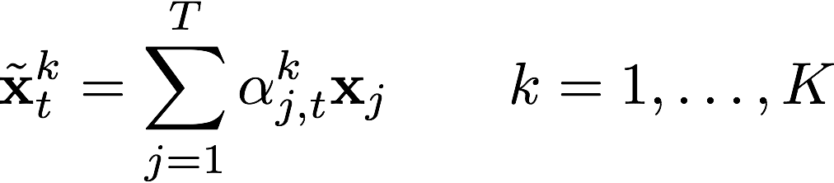
Self-Attention Layer
Idea: latent graph on text
Inductive bias:
  relationships between word pairs
compute K separate weighted word representation(s) of the context for each word t
Advantages
  can capture long-range dependencies
  Parallelizable and fast
Disadvantages
  careful setup of hyper-parameters
  potentially memory intensive computation of attention weights for large contexts, O(T * T * K)
Good for: phrases, sentences, paragraphs
move
from
Gospić
to
Prague
Notes:
- The new kid on the block!

Slide 20
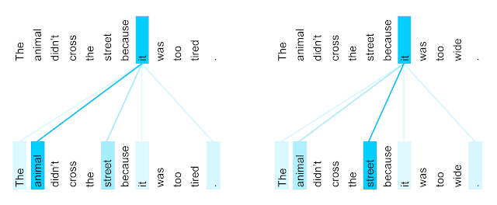
Self-Attention Layer
Graph with weighted edges of K types
Can capture:
  coreference chains
  syntactic dependency structure in text
Transformer Self-Attention Coreference Visualization
https://ai.googleblog.com/2017/08/transformer-novel-neural-network.html
Notes:
Connection with Winograd schemas

Slide 21
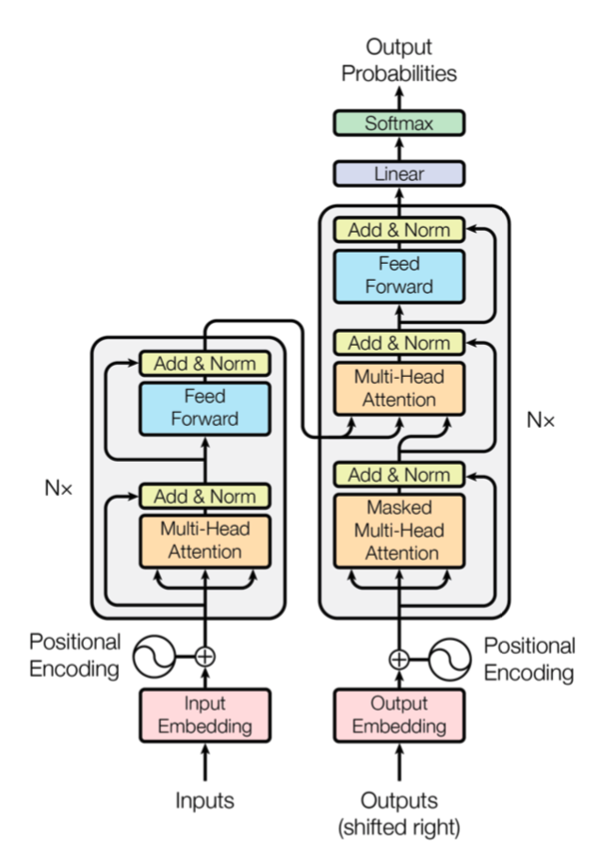
Transformer
Vaswani et al., NIPS’17
Residual connections before and after multi-head attention
Decoder uses both self attention and encoder attention
Figure from Vaswani et al., NIPS’17

Slide 22
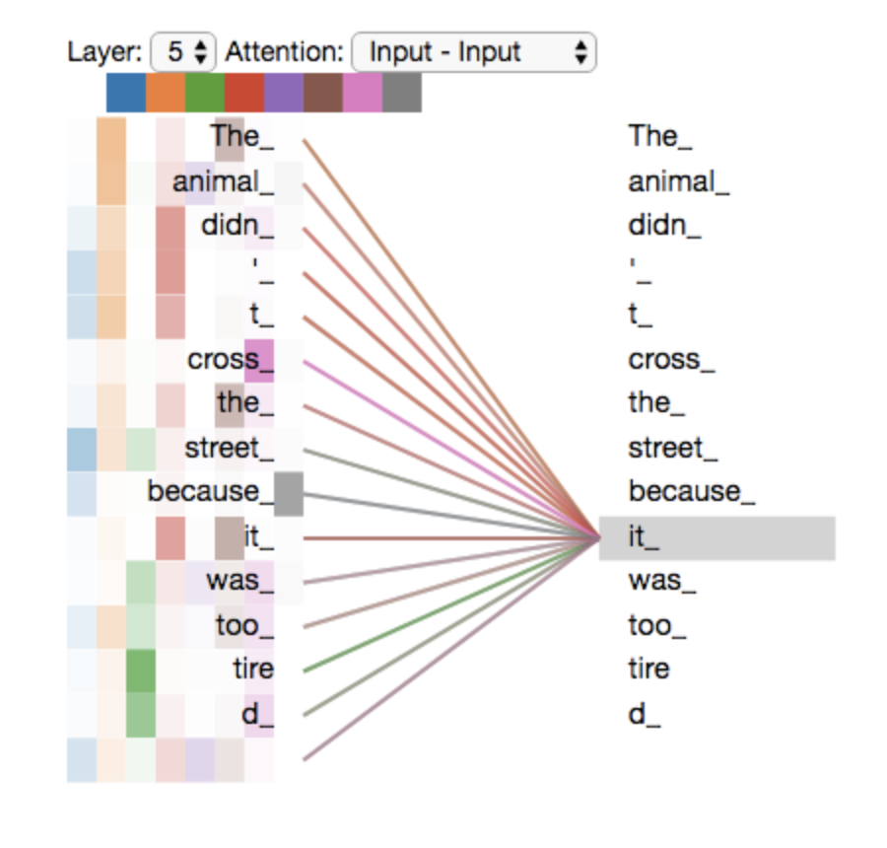
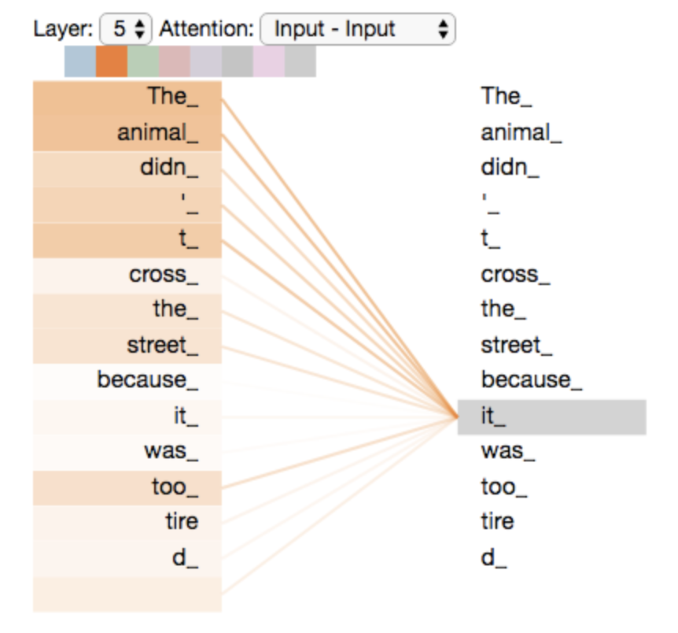
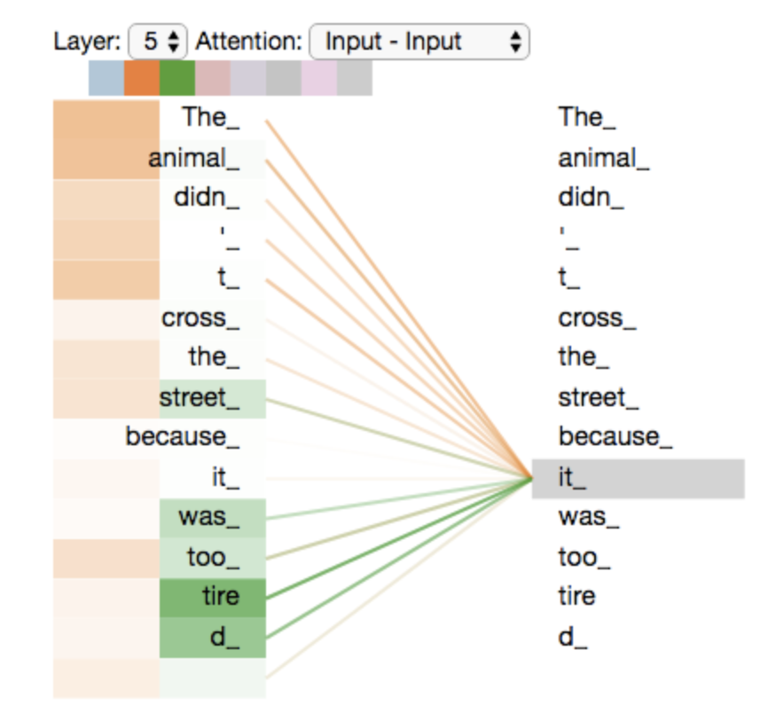
Multi-head attention
Figures from http://jalammar.github.io/illustrated-transformer/

Slide 23
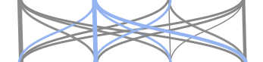


Compositional Sequence Encoders - Overview
Language is compositional!
  Characters → Words → Phrases → Clauses → Sentences → Paragraphs → Documents
Architecture | RNN (LSTM, GRU) | CNN | Self-Attention
Illustration
Function
Advantages | - unlimited context - recency bias | - parallelizable → fast - local n-gram patterns | - parallelizable → fast - long-range dep
Disadvantages | - slower - strong recency bias - long-range dep | - limited context - strong locality bias - long-range dep | - harder to train - careful setup of hyper-parameters

Slide 24
Answer prediction
Usually linear projection
Probability distribution over different answer options
  Multiple choices: candidates
  Spans in text -- distribution over positions for beginning and end (as in SQuAD)
  Answer generation
Training:
  Cross-entropy loss
  Ranking loss

Slide 25
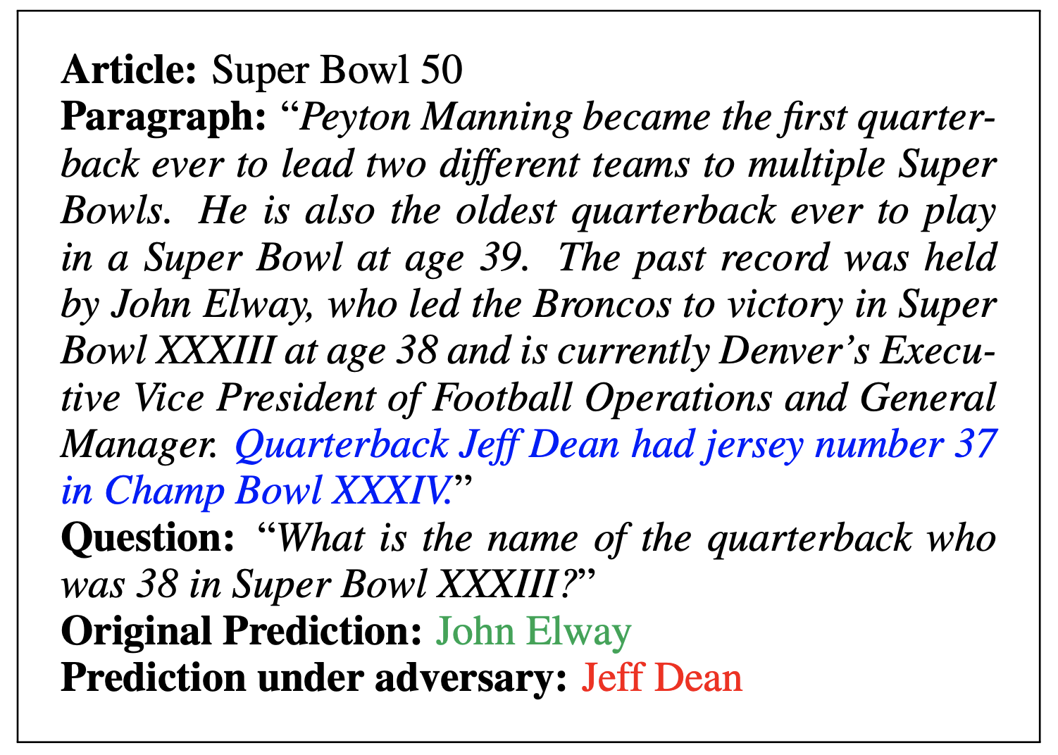
SQUAD training: limitations
Models are brittle
Very easy to come up with adversarial example
[Jia & Liang, 2017]

Slide 26
Machine Reading / Current Trend

Slide 27
Supervised training
Neural net encoder for MR
[...] Precipitation forms as smaller droplets coalesce via collision with other rain drops or ice crystals within a cloud. Short, intense periods of rain in scattered locations are called “showers”.
?
Where do water droplets collide with ice crystals to form precipitation?
within a cloud
[Passage of Text]
[Meaning]
[Information Need]

Slide 28
Unsupervised pretrained representations
Neural net encoder for (just) text
In January 1880, two of Tesla's uncles put together enough money to help him leave Gospić for Prague where he was to study. Unfortunately, he arrived too late to enrol at Charles-Ferdinand University; he never studied Greek, a required subject; and he was illiterate in Czech, another required subject. Tesla did, however, attend lectures at the university, although, as an auditor, he did not receive grades for the courses.
?
In January 1880, two of Tesla's uncles put together enough money to help him leave Gospić for Prague where he was to study. Unfortunately, he arrived too late to enrol at Charles-Ferdinand University; he never studied Greek, a required subject; and he was illiterate in Czech, another required subject. Tesla did, however, attend lectures at the university, although, as an auditor, he did not receive grades for the courses.
In January 1880, two of Tesla's uncles put together enough money to help him leave Gospić for Prague where he was to study. Unfortunately, he arrived too late to enrol at Charles-Ferdinand University; he never studied Greek, a required subject; and he was illiterate in Czech, another required subject. Tesla did, however, attend lectures at the university, although, as an auditor, he did not receive grades for the courses.
In January 1880, two of Tesla's uncles put together enough money to help him leave Gospić for Prague where he was to study. Unfortunately, he arrived too late to enrol at Charles-Ferdinand University; he never studied Greek, a required subject; and he was illiterate in Czech, another required subject. Tesla did, however, attend lectures at the university, although, as an auditor, he did not receive grades for the courses.
[...] Precipitation forms as smaller droplets coalesce via collision with other rain drops or ice crystals within a cloud. Short, intense periods of rain in scattered locations are called “showers”.
[...] Precipitation forms as smaller droplets coalesce via collision with other rain drops or ice crystals within a cloud. Short, intense periods of rain in scattered locations are called “showers”.
[A lot of text]
[Meaning]
[A lot of text]

Slide 29
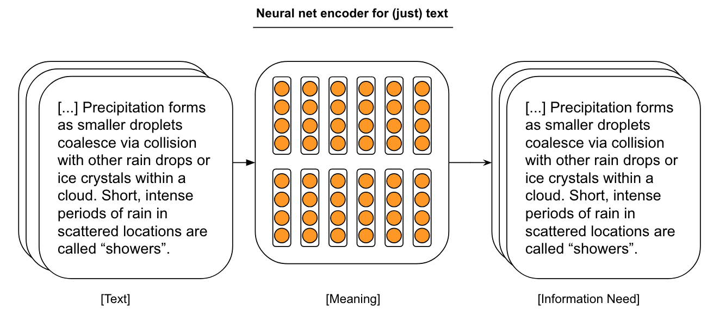
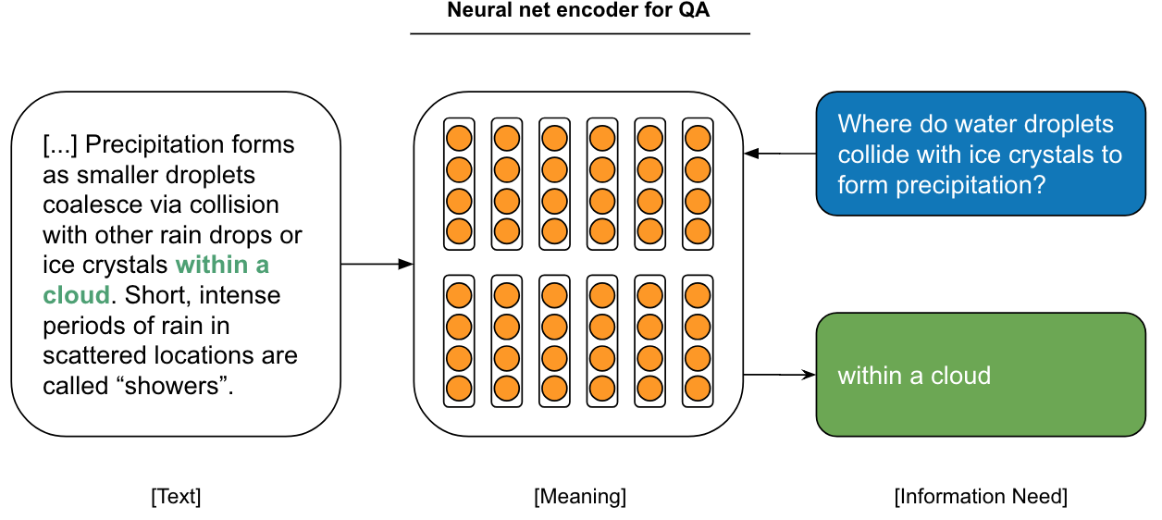
Lifting over pretrained representations
Pretrained Language Model
Transfer
Machine Reading

Slide 30
How is this different from pretrained word embeddings?
Pretrained Word Embeddings (word2vec)
Predicting co-occurring of words
Independent of other context
Pretrained Contextualized Embeddings (e.g. ELMo, BERT)
Predicting whole text (using LSTM, or Self-Attention)
Full dependence on other context

Slide 31
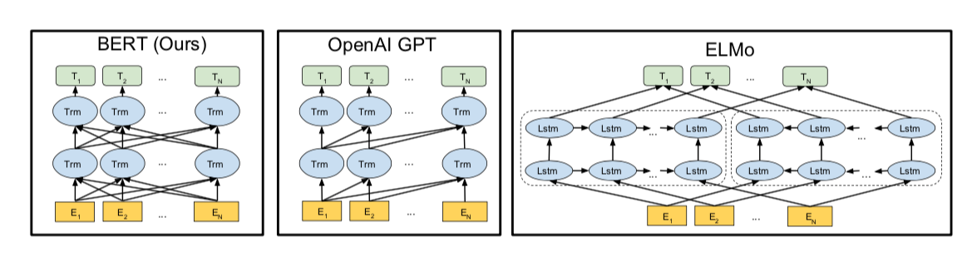
ELMo: Embeddings from Language Models
Peters et al., NAACL’18
Train a BiLSTM for Bidirectional language modeling on a large dataset
Run the sentence to encode through both forward and backward LSTMs
Combine forward and backward representations into final contextual embeddings

Slide 32
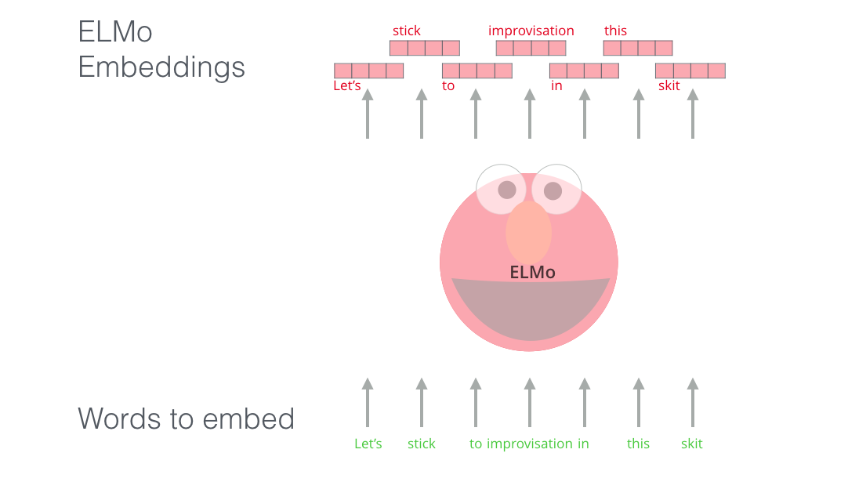
ELMo: Embeddings from Language Models
Figures from http://jalammar.github.io/illustrated-bert/

Slide 33
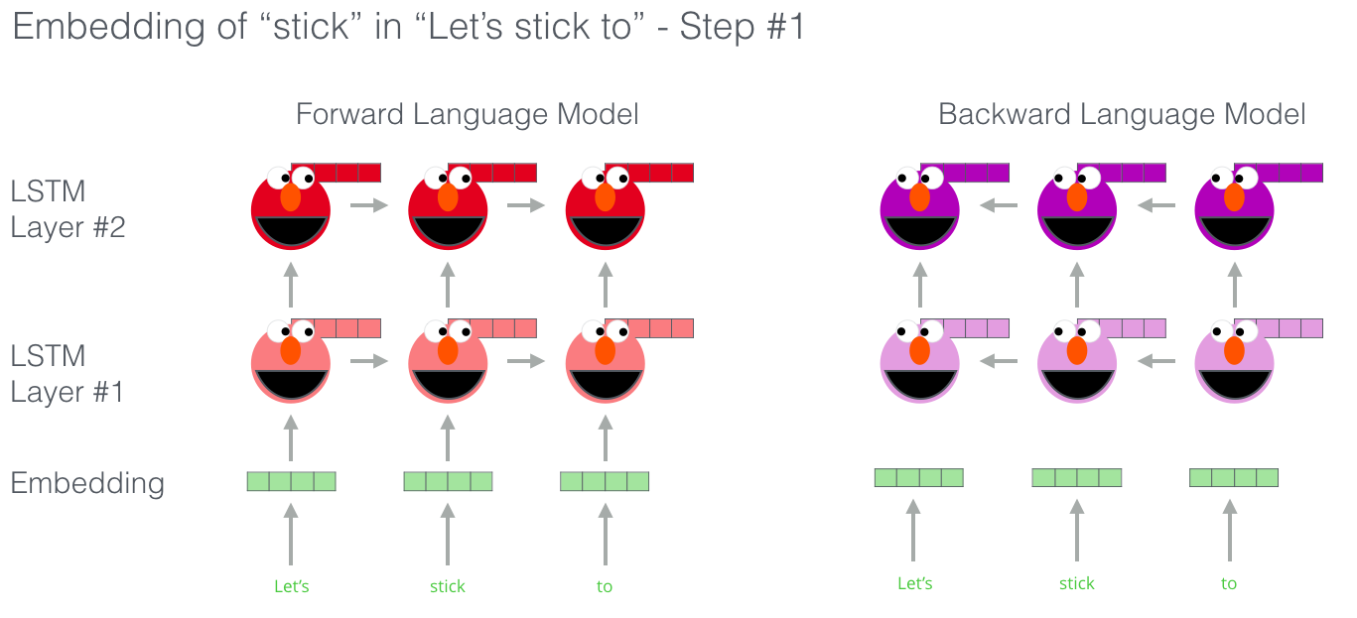
ELMo: Embeddings from Language Models
Figures from http://jalammar.github.io/illustrated-bert/

Slide 34
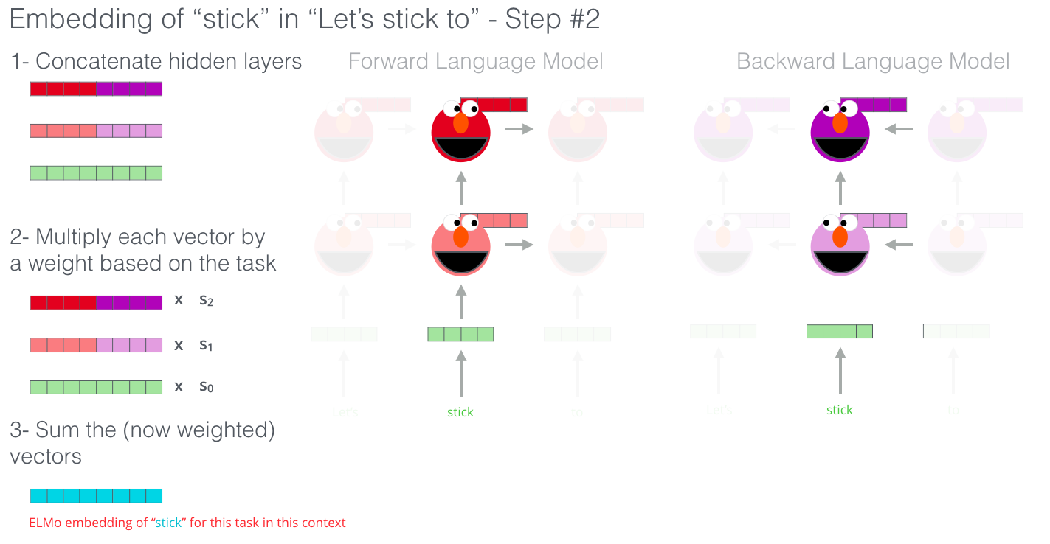
ELMo: Embeddings from Language Models
Figures from http://jalammar.github.io/illustrated-bert/

Slide 35
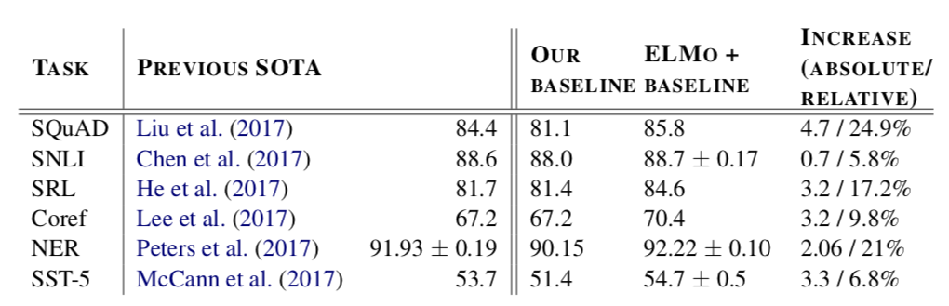
ELMo performance
Machine Reading -
Textual Entailment -
Semantic Labeling -
Coreference Resolution -
Entity Extraction -
Sentiment Analysis -

Slide 36
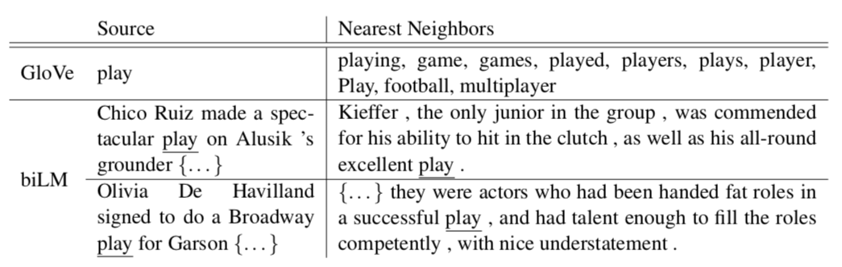
What is ELMo learning ?
Meaning of words in context
  POS, word sense, etc.

Slide 37
BERT - Bidirectional Encoder Representations from Transformers
Devlin et al., NAACL’19
Solutions: use Transformer + encoder layers instead of decoder layers
(OpenAI GPT)
Innovation with multiple pretraining tasks

Slide 38
BERT – Pretraining 1: masked language modeling
Given a sentence with some words masked at random, can we predict them?
Randomly select 15% of tokens to be replaced with “<MASK>”

Slide 39
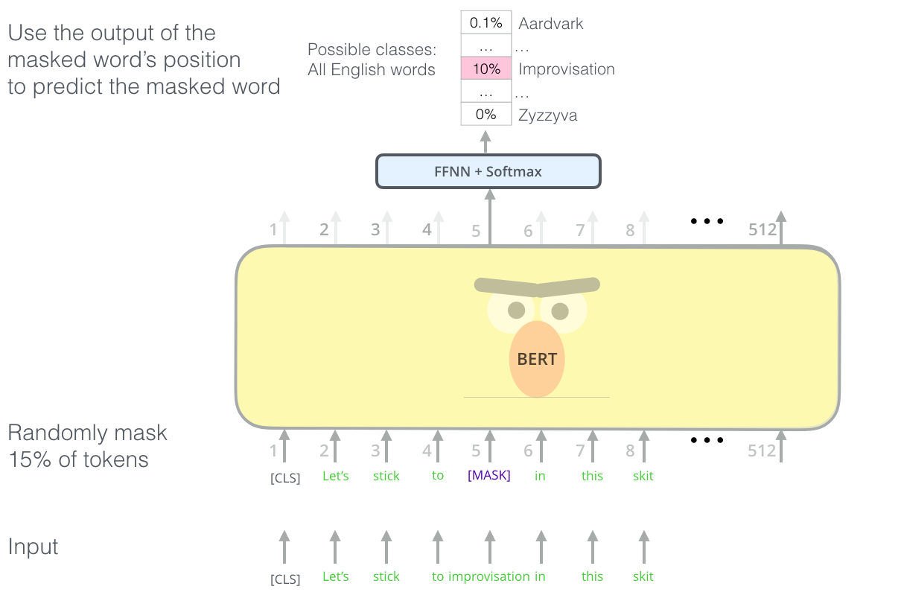
BERT – Pretraining 1: masked language modeling
Figures from http://jalammar.github.io/illustrated-bert/

Slide 40
BERT – Pretraining 2: next sentence prediction
Given two sentences, does the first follow the second?
Teaches BERT about relationship between two sentences
50% of the time the actual next sentence, 50% random

Slide 41
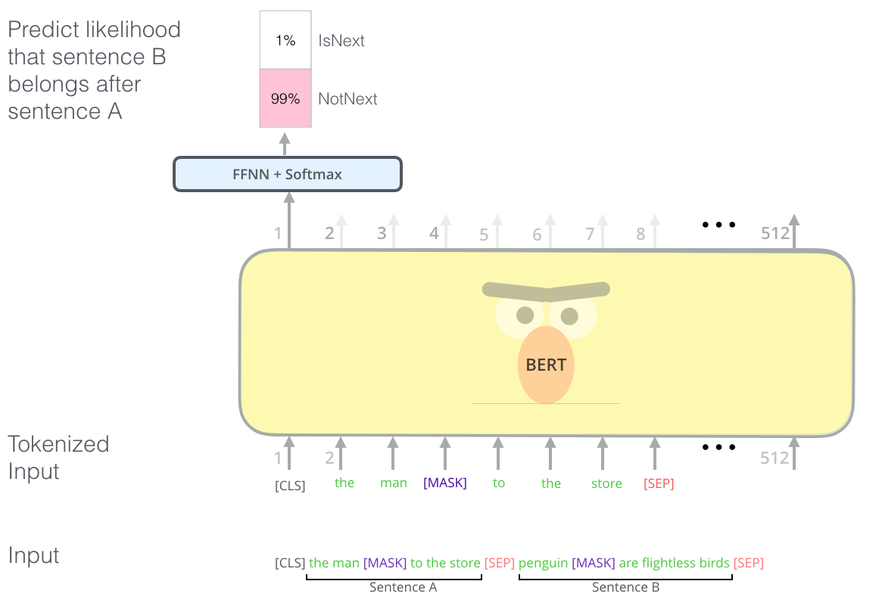
BERT – Pretraining 2: next sentence prediction
Figures from http://jalammar.github.io/illustrated-bert/

Slide 42
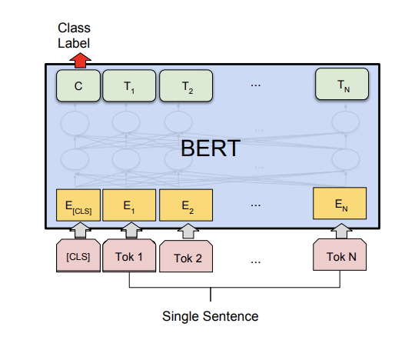
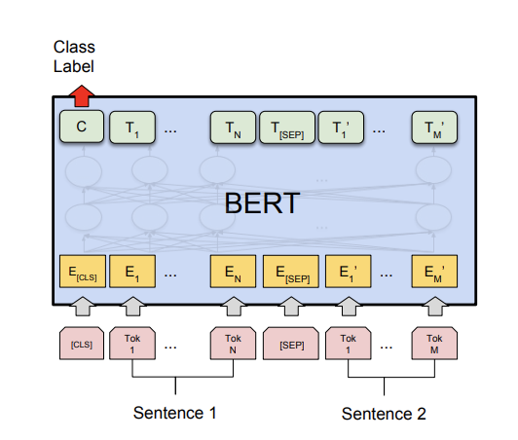
BERT – Fine-tuning for Classification
Single sentence classification
Sentiment analysis, spam detection, etc.
Pair of sentences classification
Entailment, paraphrase detection, etc.
Figures from Devlin et al. 18'

Slide 43
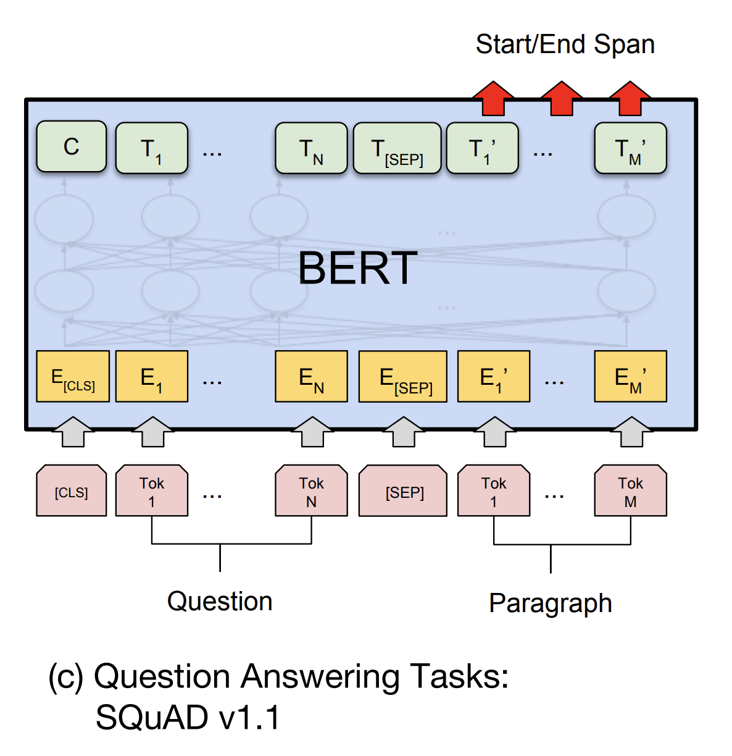
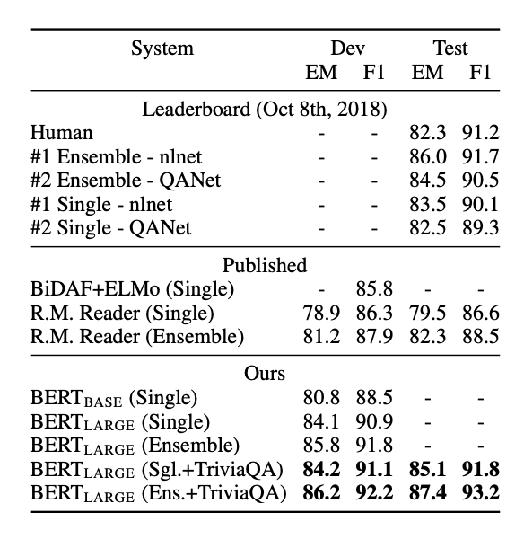
BERT – Fine-tuning for Machine Reading
Figures from Devlin et al. 18'

Slide 44
Dialog
How about language with interactions?

Slide 45
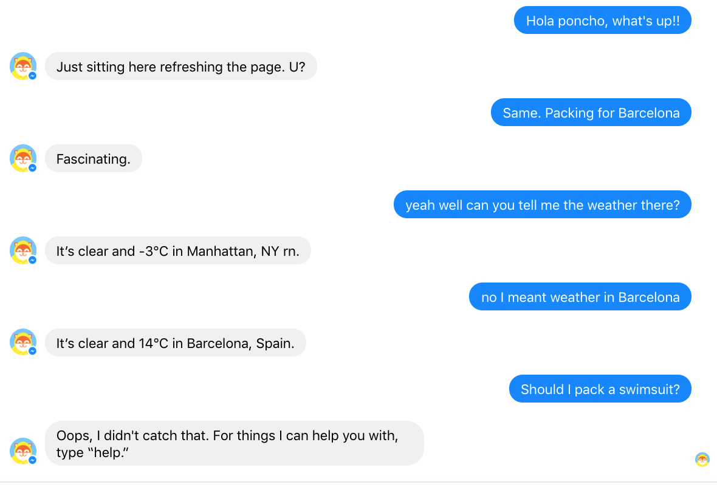

Bots! Bots! Bots!

Slide 46
Terms
Utterance: single sentence or line produced by a human or a dialog agent.
Turn: one utterance in a sequence of consecutive utterances
Dialog:
  A sequence of turns
  This can be as few of two turns
Context: Either outside information or previous turns in the dialog
These all refer to a dialog with two turns:
  Source/target pair
  Query/response pair
  Message/response pair

Slide 47
Types of Dialog Systems
Goal-oriented Dialog Agents
Goals:
  have short conversations
  getting information from the user to help complete a specific task.
Implementation:
  Rule-based
  End-to-end (a bit)
Evaluation: Goal achieved or not
Chatbots/chit-chat bots
Goals:
  mimic the unstructured conversations characteristic of human-human interaction.
  engage user as long as possible
  Sometimes accomplish an indirect task
Implementation
  Rule-based
  Information retrieval
  End-to-End
Evaluation: User is having a good time?

Slide 48
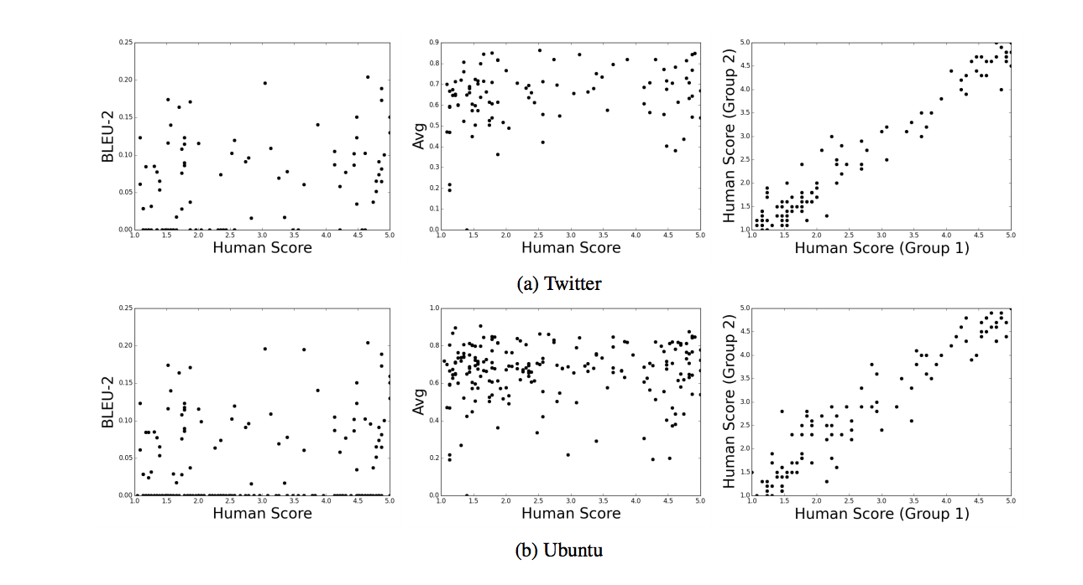
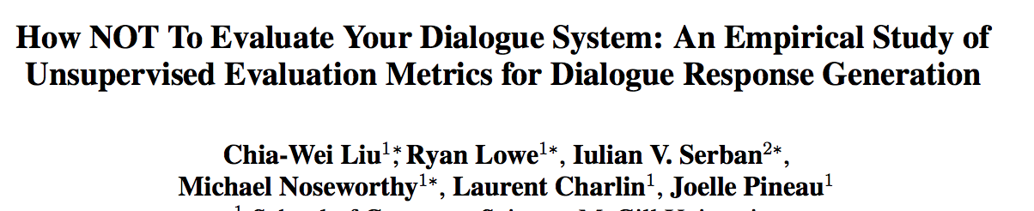
Dialog evaluation is hard
Human evaluations (AMT, etc.):
  PROS: test fluency, task completion, actual task
  CONS: costly, non-reproducible
Automatic evaluation (BLEU, perplexity, etc.)
  PROS: fast, scalable, reproducible,
  CONS: non-correlated with actual human eval.
“many metrics commonly used in the literature for evaluating unsupervised dialogue systems do not correlate strongly with human judgement.”

Slide 49
Dialog / Goal-oriented

Slide 50
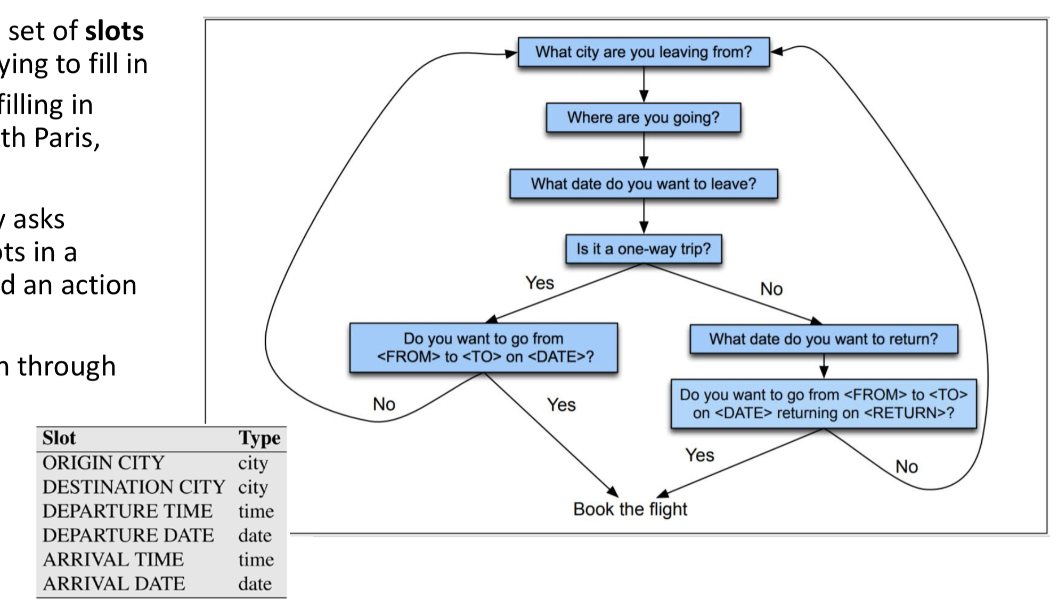
Frame-Based Agents for Goal-oriented Dialog
A frame consists of a set of slots the dialog agent is trying to fill in
  i.e. Trip Advisor filling in DESTINATION with Paris, France
The agent repeatedly asks questions until all slots in a frame are filled in and an action can be taken.
Questions are chosen through use of an Finite-State Automaton

Slide 51
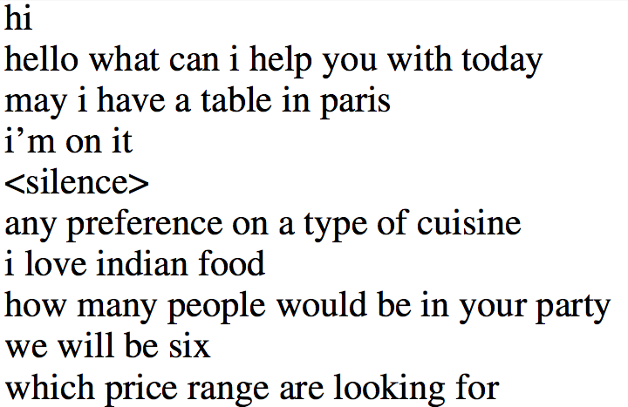
End-to-end Dialog Systems
Shang et al., 15; Vinyals and Le, 15; Sordoni et al., 15; Serban et al., 15; Dodge et al., 16
only input/output given
?
In a moderate price range please?
[Query]
Ok let me look into some options for you?
[Context]
[Meaning]
[Response]

Slide 52
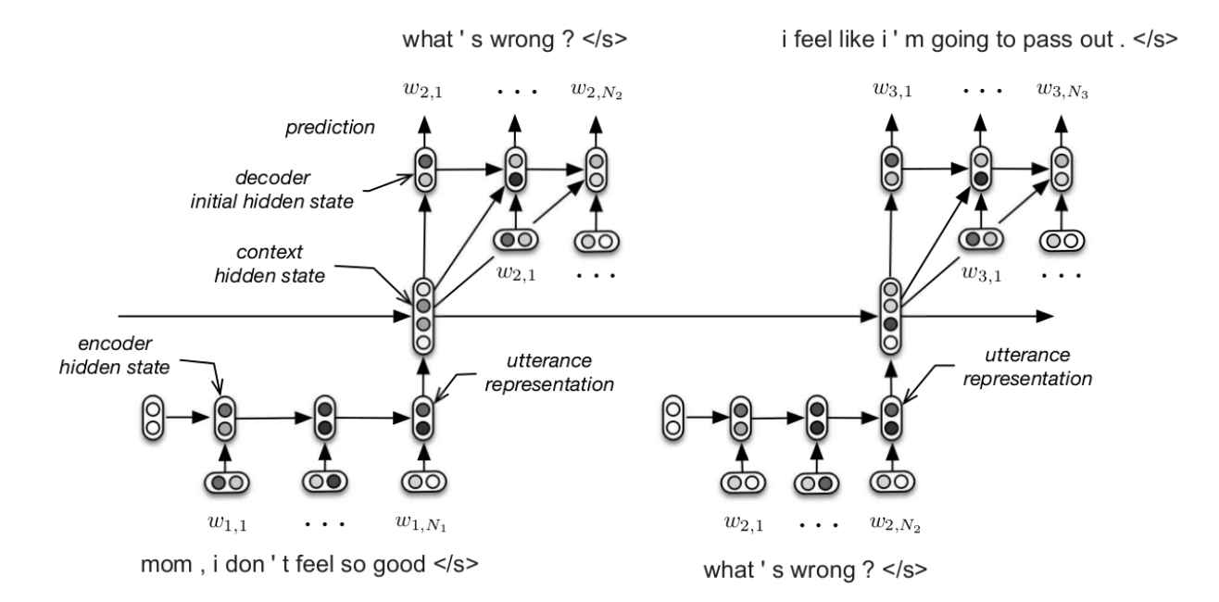
End-to-end Dialog Systems
Shang et al., 15; Vinyals and Le, 15; Sordoni et al., 15; Serban et al., 15; Dodge et al., 16
only input/output given
?
In a moderate price range please?
[Query]
Ok let me look into some options for you?
[Context]
[Meaning]
[Response]
No intermediate task or state that can be used for training and evaluation!

Slide 53
A dataset for end-to-end goal oriented dialog
Based on a simulation:
  A knowledge base (KB) made of restaurants and their properties: type of cuisine, location, price, rating, party size, address and phone number.
  KB can be queried using API calls containing 4fields: location, type of cuisine, price range and party size.
  Dialogs are generated after creating a user request by sampling an API call.
Each example is a dialog between a user and a bot, as well as API calls and the resulting facts.
NL patterns are used to create user and bot utterances.
Learning End-to-End Goal-Oriented Dialog [Bordes, ICLR 2017]

Slide 54
Slicing a booking in five tasks
Task completed
=
All utterances correctly predicted

Slide 55
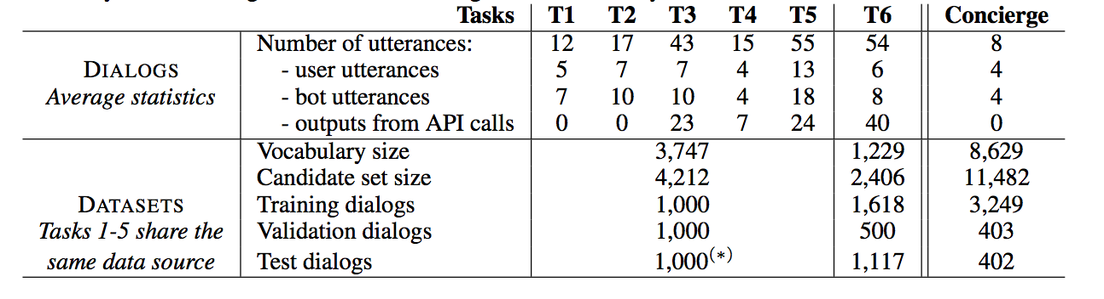
Stats

Slide 56
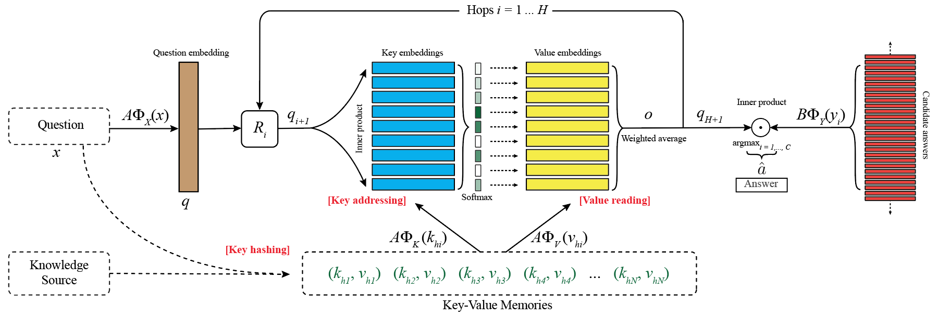
End-to-end Model: Memory Networks
In Barcelona
How many …
How many people in your party ?
(m₁, m₂, m₃, m₄, …)
(m₁, m₂, m₃, m₄, …)
m1: U: Hi
m2: B: Hello
I’m on it
John
Memories
U: Hi
B: Hello
U: I would like a table for two
B: Sure thing
B: Where would that be ?
Memories
m4: B: Sure thing
m5: B: Where would that be?
Hi
m3: U: I would like a table for two
…

Slide 57
Dashboard
 | IR (TF-IDF) | LSTMs | Embeddings | Memory Networks | Top perf
T1 – API calls | 5.6 | / | 100 | 99.9 | 100
T2 – Update API calls | 3.4 | / | 68.4 | 100 | 100
T3 – Show options | 8.0 | / | 64.9 | 74.9 | 100
T4 – Extra information | 9.5 | / | 57.2 | 59.5 | 100
T5 – Full dialogs | 4.6 | / | 75.4 | 96.1 | 100
T6 – DSTC2 | 1.6 | / | 22.6 | 41.1 | ?
T7 – Concierge | 1.1 | / | 14.6 | 16.7 | ?
All datasets agree
Memory Networks can not learn to use the KB

Slide 58
Dashboard
 | IR (TF-IDF) | LSTMs | Embeddings | Memory Networks | Top perf
T1 – API calls | 5.6 | / | 100 | 99.9 | 100
T2 – Update API calls | 3.4 | / | 68.4 | 100 | 100
T3 – Show options | 8.0 | / | 64.9 | 74.9 | 100
T4 – Extra information | 9.5 | / | 57.2 | 59.5 | 100
T5 – Full dialogs | 4.6 | / | 75.4 | 96.1 | 100
T6 – DSTC2 | 1.6 | / | 22.6 | 41.1 | ?
T7 – Concierge | 1.1 | / | 14.6 | 16.7 | ?
What if Out-of-Vocabulary entities?

Slide 59
Dashboard
 | IR (TF-IDF) | LSTMs | Embeddings | Memory Networks | Top perf
T1 – API calls | 5.8 +0.2 | / | 60.0 -40.0 | 72.3 -27.6 | 100
T2 – Update API calls | 3.5 +0.1 | / | 68.3 -0.1 | 78.9 -21.1 | 100
T3 – Show options | 8.3 +0.3 | / | 65.0 +0.1 | 74.4 -0.5 | 100
T4 – Extra information | 9.8 +0.3 | / | 57.0 -0.2 | 57.6 -1.9 | 100
T5 – Full dialogs | 4.6 +0.0 | / | 48.2 -27.2 | 65.5 -30.6 | 100
T6 – DSTC2 | 1.6 | / | 22.6 | 41.1 | /
T7 – Concierge | 1.1 | / | 14.6 | 16.7 | /
What if Out-of-Vocabulary entities?
OOV are not obvious for embedding-based models.

Slide 60
Dashboard
Memory Networks + type features
96.5
94.5
75.2
100
77.7
41.0
 | IR (TF-IDF) | LSTMs | Embeddings | Memory Networks | Top perf
T1 – API calls | 5.8 +0.2 | / | 60.0 -40.0 | 72.3 -27.6 | 100
T2 – Update API calls | 3.5 +0.1 | / | 68.3 -0.1 | 78.9 -21.1 | 100
T3 – Show options | 8.3 +0.3 | / | 65.0 +0.1 | 74.4 -0.5 | 100
T4 – Extra information | 9.8 +0.3 | / | 57.0 -0.2 | 57.6 -1.9 | 100
T5 – Full dialogs | 4.6 +0.0 | / | 48.2 -27.2 | 65.5 -30.6 | 100
T6 – DSTC2 | 1.6 | / | 22.6 | 41.1 | /
T7 – Concierge | 1.1 | / | 14.6 | 16.7 | /
What if Out-of-Vocabulary entities?
Adding type features can help to fix some limitations

Slide 61
Dialog / Chatbots

Slide 62
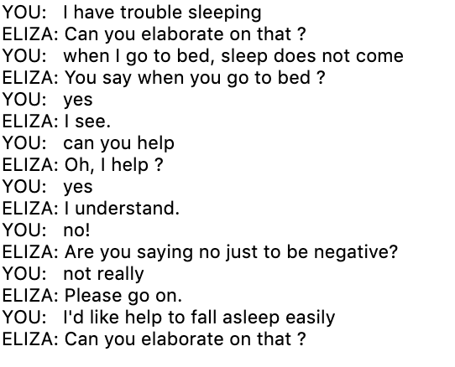
Eliza – A rule-base chatbot
Weizenbaum,1966
Goal: Mimic the responses of a non-directional psychotherapist
Approach: Pattern matching and substitution rules and a memory/storage mechanism

Slide 63
Datasets for chit-chat
Twitter
2.6 million query-response pairs.
OpenSubtitles
>2.5 billion sentences
not speaker aligned
SubTle
6.7 million utterances in 3.35 dialogs
speaker aligned
Ubuntu Dialogue Corpus
930k dialogs with average 7.71 turns each
PersonaChat – humans were given personas and asked to converse
164,356 utterances over 10,981 dialogs
“A Survey of Available Corpora for Building Data-Driven Dialogue Systems” (Serban et al. 2017)

Slide 64
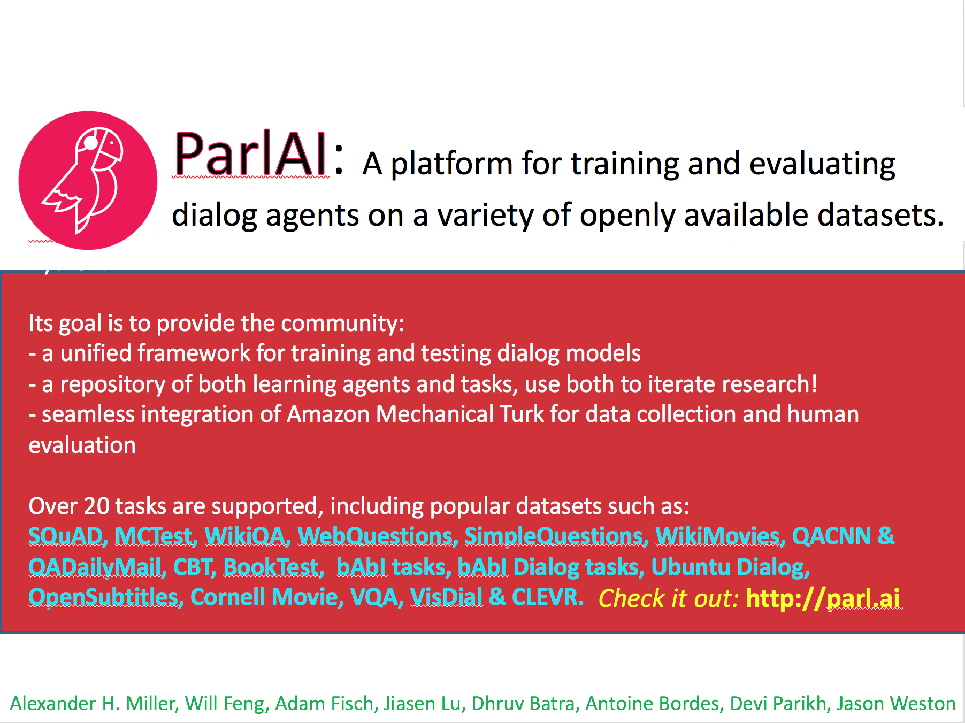
+ Kurt Shuster, Emily Dinan, Jack Urbanek

Slide 65
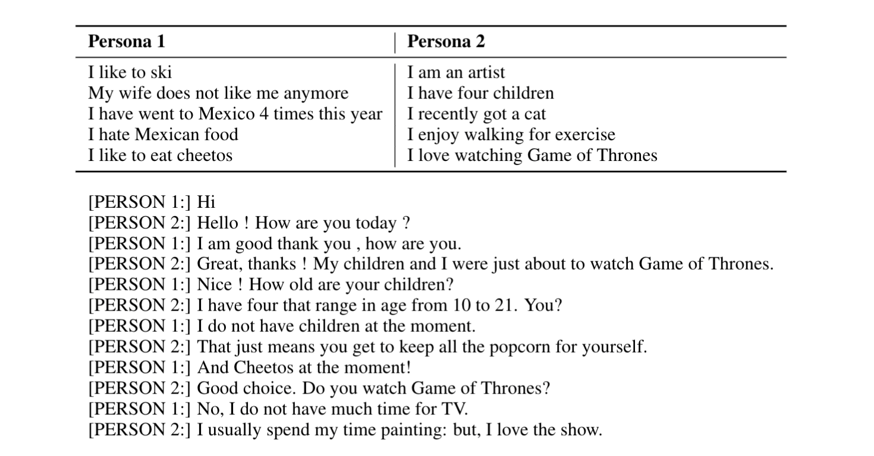
PersonaChat
Zhang et al., ACL’18

Slide 66
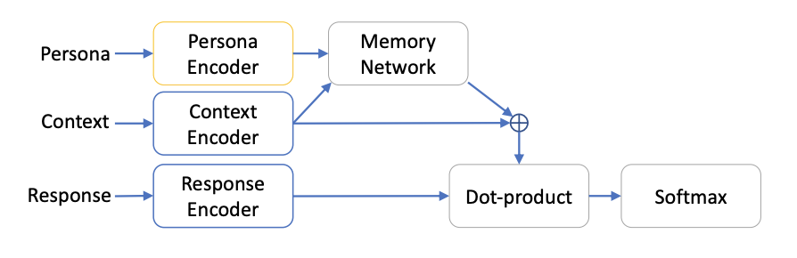
A retrieval model
Mazaré et al., EMNLP’18

Slide 67
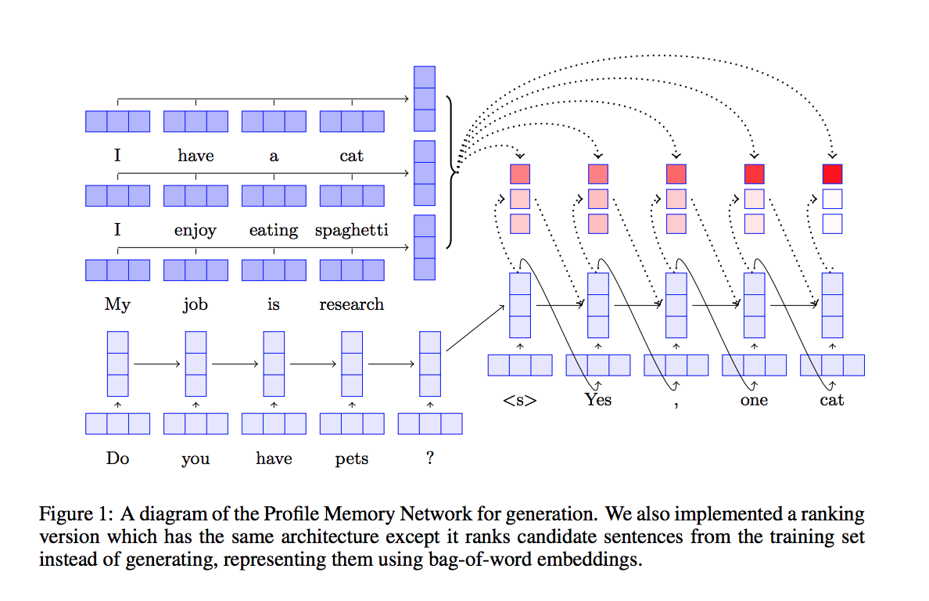
A generative model
Zhang et al., ACL’18

Slide 68
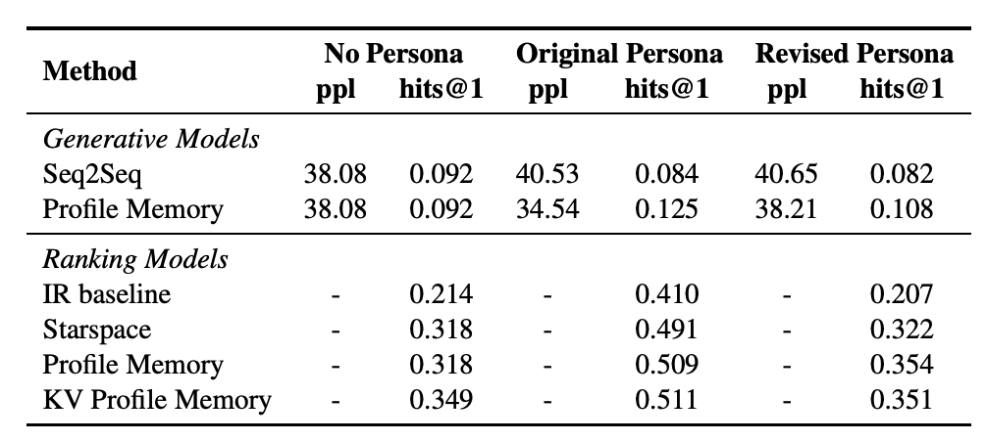
Automatic evaluation

Slide 69


Human Evaluation
We asked the human to evaluate their partner after the dialogue (we didn’t tell them if it’s a human or a bot).
NOTE: we also tried asking humans to evaluate fixed dialogues they didn’t take part in, but the scores were squashed towards the mean, crowd workers were not engaged. So we abandoned this approach.

Slide 70

Human evaluations

Slide 71

Person_1 is a human
Person_2 is the bot
(generative)

Slide 72

Person_1 is a human
Person_2 is the bot
(retrieval)

Slide 73

Dialog is about interaction – can we use it?
Hancock et al., 2019

Slide 74

A self-feeding chatbot
Hancock et al., 2019

Slide 75
Open topics
Active learning from interactions
Reinforcement learning from interactions
Safety
Mixing information-retrieval with generative models
Multimodal (conversing about an image)
Open-domain: talking about anything, mixing goal-oriented and chit-chat.
Need interactions at scale!!

Slide 76
Joint testing on different tasks?
Dialog systems should be open-domain!
Dialog is not monolithic:
  Ask facts?
  Ask for opinions (recommendations)?
  Dialog combining facts and opinions?
  General chit-chat (statements not questions)?
Combination of all above in one end-to-end model?

Slide 77




Multi-task dialog dataset(s)
Dodge et al., ICLR’16

Slide 78
References Compositional Sequence Encoders
Peters, M. E., Neumann, M., Iyyer, M., Gardner, M., Clark, C., Lee, K., & Zettlemoyer, L. (2018). Deep contextualized word representations. NAACL.
McCann, B., Bradbury, J., Xiong, C., & Socher, R. (2017). Learned in translation: Contextualized word vectors. NIPS.
Radford, A., Narasimhan, K., Salimans, T., & Sutskever, I. (2018). Improving Language Understanding by Generative Pre-Training. arXiv.
Howard, J. & Ruder, S. (2018). Universal Language Model Fine-tuning for Text Classification. ACL.
Vaswani, A., Shazeer, N., Parmar, N., Uszkoreit, J., Jones, L., Gomez, A. N., Kaiser, Ł. & Polosukhin, I. (2017). Attention is all you need. NIPS.
Cheng, J., Dong, L., & Lapata, M. (2016). Long short-term memory-networks for machine reading. EMNLP.
Wang, W., Yang, N., Wei, F., Chang, B., & Zhou, M. (2017). Gated self-matching networks for reading comprehension and question answering. ACL.
Yu, A. W., Dohan, D., Luong, M. T., Zhao, R., Chen, K., Norouzi, M., & Le, Q. V. (2018). QANet: Combining Local Convolution with Global Self-Attention for Reading Comprehension. ICLR.
Yang, Z., Zhao, J., Dhingra, B., He, K., Cohen, W. W., Salakhutdinov, R., & LeCun, Y. (2018). GLoMo: Unsupervisedly Learned Relational Graphs as Transferable Representations. arXiv.
Tai, K. S., Socher, R., & Manning, C. D. (2015). Improved semantic representations from tree-structured long short-term memory networks. ACL.
Dyer, C., Kuncoro, A., Ballesteros, M., & Smith, N. A. (2016). Recurrent Neural Network Grammars. NAACL.

Slide 79
References Interaction
Cho, K., Gulcehre, B. V. M. C., Bahdanau, D., Schwenk, F. B. H., & Bengio, Y. (2014). Learning Phrase Representations using RNN Encoder–Decoder for Statistical Machine Translation. EMNLP.
Sutskever, I., Vinyals, O., & Le, Q. V. (2014). Sequence to sequence learning with neural networks. NIPS.
Bahdanau, D., Cho, K., & Bengio, Y. (2015). Neural machine translation by jointly learning to align and translate. ICLR.
Sukhbaatar, S., Weston, J., & Fergus, R. (2015). End-to-end memory networks. NIPS.
Kumar, A., Irsoy, O., Ondruska, P., Iyyer, M., Bradbury, J., Gulrajani, I., ... & Socher, R. (2016). Ask me anything: Dynamic memory networks for natural language processing. ICML.
Graves, A., Wayne, G., Reynolds, M., Harley, T., Danihelka, I., Grabska-Barwińska, A., ... & Badia, A. P. (2016). Hybrid computing using a neural network with dynamic external memory. Nature
Grefenstette, E., Hermann, K. M., Suleyman, M., & Blunsom, P. (2015). NIPS.
Henaff, M., Weston, J., Szlam, A., Bordes, A., & LeCun, Y. (2017). Tracking the world state with recurrent entity networks. ICLR.
Rocktäschel, T., Grefenstette, E., Hermann, K. M., Kočiský, T., & Blunsom, P. (2016). Reasoning about entailment with neural attention. ICLR.
Yu, A. W., Dohan, D., Luong, M. T., Zhao, R., Chen, K., Norouzi, M., & Le, Q. V. (2018). QANet: Combining Local Convolution with Global Self-Attention for Reading Comprehension. ICLR.

Slide 80
References
Adversarial Examples for Evaluating Reading Comprehension Systems (Jia et al. 2017, EMNLP)
Know What You Don’t Know: Unanswerable Questions for SQuAD (Rajpurkar et al. 2018, ACL)
Visual question answering: Datasets, algorithms, and future challenges (Kafle et al. 2017, Computer Vision and Image Understanding)
Making the V in VQA Matter: Elevating the Role of Image Understanding in Visual Question Answering (Goyal et al. 2017, CVPR)
Reading Wikipedia to Answer Open-Domain Questions (Chen et al. 2017, ACL)
Event2Mind: Commonsense Inference on Events, Intents, and Reactions (Rashkin et al. 2018, arXiv)
Semantically Equivalent Adversarial Rules for Debugging NLP Models (Ribeiro 2018, ACL)
Understanding Neural Networks through Representation Erasure (Li et al. 2016, arXiv)
HotFLip: White-Box Adversarial Examples for NLP (Ebrahimi et al. 2017, arXiv)
Anchors: High-Precision Model-Agnostic Explanations (Ribeiro et al. 2018, AAAI)
Deep contextualized word representations (Peters et al. 2018, NAACL)
Learned in Translation: Contextualized Word Vectors (McCann et al. 2017, NIPS)
Supervised Learning of Universal Sentence Representations from Natural Language Inference Data (Conneau et al. 2017, EMNLP)
Efficient Estimation of Word Representations in Vector Space (Mikolov et al. 2013, NIPS)
Simple and Effective Semi-Supervised Question Answering (Dhingra et al. NAACL 2018)
Neural Domain Adaptation for Biomedical Question Answering (Wiese et al. 2017, CoNLL)
Improving Language Understanding by Generative Pre-Training (Radford et al. 2018, arXiv)
Neural Skill Transfer from Supervised Language Tasks to Reading Comprehension (Mihaylov et al. 2017, arXiv)
Representing General Relational Knowledge in ConceptNet 5 (Speer and Havasi, LREC 2012)
Learning to understand phrases by embedding the dictionary (Hill et al. 2016, TACL)
Leveraging knowledge bases in lstms for improving machine reading (Yang et al. 2017, ACL)
Knowledgeable Reader: Enhancing Cloze-Style Reading Comprehension with External Commonsense Knowledge. (Mihaylov and Frank, 2018, ACL)
Reading Wikipedia to Answer Open-Domain Questions (Chen et al. 2017, ACL)
Evidence aggregation for answer re-ranking in open-domain question answering (Wang et al. ICLR 2018)
Marco Baroni and Gemma Boleda: https://www.cs.utexas.edu/~mooney/cs388/slides/dist-sem-intro-NLP-class-UT.pdf
News article: https://www.independent.co.uk/infact/brexit-second-referendum-false-claims-eu-referendum-campaign-lies-fake-news-a8113381.html

Slide 81
References for Datasets
Building a question answering test collection, Voorhees & Tice SIGIR 2000
Besting the Quiz Master: Crowdsourcing Incremental Classification Games, Boyd-Graber et al. EMNLP 2012
Semantic Parsing on Freebase from Question-Answer Pairs, Berant et al. EMNLP 2013
Mctest: A challenge dataset for the open-domain macchine comprehension of text, Richardson et al. EMNLP 2013
Teaching Machines to Read and Comprehend, Hermann et al. NIPS 2015
WikiQA: A challenge dataset for open-domain question answering, Yang et al. EMNLP 2015
Large-scale Simple Question Answering with Memory Networks, Bordes et al. 2015 arXiv:1506.02075.
The Goldilocks Principle: Reading Children’s Books with Explicit Memory Representations, Hill et al. ICLR 2016
SQuAD: 100,000+ Questions for Machine Comprehension of Text, Rajpurkar et al. EMNLP 2016
[SQuAD 2.0] Know What You Don't Know: Unanswerable Questions for SQuAD, Rajpurkar and Jia et al. ACL 2018
Towards AI-Complete Question Answering: A Set of Prerequisite Toy Tasks, Weston et al. ICLR 2016
Constraint-Based Question Answering with Knowledge Graph, Bao et al. COLING 2016
MovieQA: Understanding Stories in Movies through Question-Answering, Tapawasi et al. CVPR 2016
Who did What: A Large-Scale Person-Centered Cloze Dataset, Onishi et al. EMNLP 2016
MS MARCO: A Human Generated MAchine Reading COmprehension Dataset, Nguyen et al. NIPS 2016
The LAMBADA dataset: Word prediction requiring a broad discourse context, Paperno et al. ACL 2016
WIKIREADING: A Novel Large-scale Language Understanding Task over Wikipedia, Hewlett et al. ACL 2016
TriviaQA: A Large Scale Distantly Supervised Challenge Dataset for Reading Comprehension, Joshi et al. ACL 2017
Crowdsourcing Multiple Choice Science Questions, Welbl et al. WNUT 2017
RACE: Large-scale ReAding Comprehension Dataset From Examinations, Lai et al. EMNLP 2017
NewsQA: a Machine Comprehension Dataset, Trischler et al. RepL4NLP 2017
Science Exam Datasets by the Allen Institute for Artificial Intelligence: https://allenai.org/data/data-all.html
SearchQA: A New Q&A Dataset Augmented with Context from a Search Engine, Dunn et al. https://arxiv.org/pdf/1704.05179.pdf
Quasar: Datasets for Question Answering by Search and Reading. Dhingra et al. 2017 https://arxiv.org/abs/1707.03904
Constructing Datasets for Multi-Hop Reading Comprehension across Documents, Welbl et al. TACL 2018
The NarrativeQA Reading Comprehension Challenge, Kocisky et al. TACL 2018

